Slide 1
WANDERLUST
THE PERSONLAIZED TRVAEL PLANNING AND TRACKING APP

Slide 2
DESCRIPTION
Jetpack Compose for UI Development: Utilizes Jetpack Compose, Android's modern UI toolkit, for building a declarative and responsive user interface with minimal code.
User Registration & J login:00000000000 Allows users to register and log in to the app, creating a personalized experience based on their account details.
Personalized Accommodation Feed: Displays location-based accommodation recommendations, tailoring suggestions to the user's preferences and travel needs.
Room Database for Data Persistence: Integrates Room for local data storage, enabling offline access and efficient retrieval of user and accommodation data.
State Management with View Model: Uses View Model and Live Data to manage UI state and ensure real-time updates, providing a seamless user experience.
User-Friendly Interface: Offers a clean, intuitive interface, ensuring easy navigation and interaction, enhancing user engagement and satisfaction.

Slide 3
SOURCE CODE
Main Activity.java import android.content.Intent; import android.graphics.drawable.Drawable; import android.os.Handler; import android.support.v7.app.ActionBar; import android.support.v7.app.AppCompatActivity; import android.os.Bundle; import android.view.View; import android.widget.LinearLayout; import android.widget.Toast; import com.google.android.gms.ads.MobileAds; import com.google.android.gms.tasks.OnSuccessListener; import com.google.firebase.remoteconfig.FirebaseRemoteConfig; import com.google.firebase.remoteconfig.FirebaseRemoteConfigSettings; import com.project.wanderlust.R;

Slide 4
public class AcitivitySplashScreen extends AppCompatActivity { private int SPLASH_TIME_OUT = 8000; public LinearLayout linear; public FirebaseRemoteConfig config; public long cacheExpiration; public String adID = "ca-app-pub-3963432354728475~4835237630"; @Override protected void onCreate(Bundle savedInstanceState) { super.onCreate(savedInstanceState); // Hide the status bar. View decorView = getWindow().getDecorView(); int uiOptions = View.SYSTEM_UI_FLAG_FULLSCREEN; decorView.setSystemUiVisibility(uiOptions); MobileAds.initialize(this, adID);

Slide 5
config = FirebaseRemoteConfig.getInstance(); FirebaseRemoteConfigSettings configSettings = new FirebaseRemoteConfigSettings.Builder() .setDeveloperModeEnabled(true) .build(); config.setConfigSettings(configSettings); config.setDefaults(R.xml.config_default); cacheExpiration = 3600; if (config.getInfo().getConfigSettings().isDeveloperModeEnabled()) { cacheExpiration = 0; } setContentView(R.layout.activity_splash_screen); linear = (LinearLayout)findViewById(R.id.splashlinear); config.fetch(cacheExpiration).addOnSuccessListener(new OnSuccessListener<Void>() { @Override public void onSuccess(Void aVoid) { config.activateFetched(); String splashdisplay = config.getString("splash");

Slide 6
Drawable splash = getResources().getDrawable(getResources() .getIdentifier(splashdisplay, "drawable", getPackageName())); linear.setBackground(splash); Toast.makeText(getApplicationContext(), R.string.splashScreen,Toast.LENGTH_SHORT).show(); } }); ActionBar actionBar = getSupportActionBar(); actionBar.hide(); Handler h = new Handler(); h.postDelayed(new Runnable() { @Override public void run() { // Start your app main activity Intent i = new Intent(AcitivitySplashScreen.this, ActivityRegisterPhoneNumber.class); startActivity(i); finish(); } }, SPLASH_TIME_OUT); } }

Slide 7
app/src/main/java/com/project/wanderlust/Activities/ActionBarMenu.javapackage com.project.wanderlust.Activities; import android.content.Intent; import android.support.v7.app.AppCompatActivity; import android.view.Menu; import android.view.MenuInflater; import android.view.MenuItem; import com.google.firebase.auth.FirebaseAuth; import com.project.wanderlust.R; import com.project.wanderlust.Sensors.CompassActivity; import com.project.wanderlust.Sensors.StepCountActivity; /** * Created by PAKLAP.pk on 29-Apr-18. */ public class ActionBarMenu extends AppCompatActivity { //------------RELATED TO ACTION BAR------------------//

Slide 8
@Override public boolean onCreateOptionsMenu(Menu menu) { MenuInflater inflater = getMenuInflater(); inflater.inflate(R.menu.actionbar, menu); return true; } public boolean onOptionsItemSelected(MenuItem item) { // Handle item selection switch (item.getItemId()) { case R.id.Profile: { Intent intent = new Intent(this, ActivityUserDetails.class); intent.putExtra("phoneNumber", FirebaseAuth.getInstance().getCurrentUser().getPhoneNumber()); intent.setFlags(Intent.FLAG_ACTIVITY_REORDER_TO_FRONT); startActivity(intent); return true;

Slide 9
} case R.id.InviteLink: { Intent intent = new Intent(this, ActivityExtra.class); intent.setFlags(Intent.FLAG_ACTIVITY_REORDER_TO_FRONT); startActivity(intent); return true; } case R.id.voice: { Intent intent = new Intent(this, ActivityVoice.class); intent.setFlags(Intent.FLAG_ACTIVITY_REORDER_TO_FRONT); startActivity(intent); return true; } case android.R.id.home: { onBackPressed(); return true; }

Slide 10
case R.id.Compass: { Intent intent = new Intent(this, CompassActivity.class); intent.setFlags(Intent.FLAG_ACTIVITY_REORDER_TO_FRONT); startActivity(intent); return true; } case R.id.StepCount: { Intent intent = new Intent(this, StepCountActivity.class); intent.setFlags(Intent.FLAG_ACTIVITY_REORDER_TO_FRONT); startActivity(intent); return true; } case R.id.Share: {

Slide 11
Intent intent = new Intent(this, ActivityShareOptions.class); intent.setFlags(Intent.FLAG_ACTIVITY_REORDER_TO_FRONT); startActivity(intent); return true; } default: return super.onOptionsItemSelected(item); } } //-----------------------------------------------------------------------// }

Slide 12
app/app.iml<?xml version="1.0" encoding="UTF-8"?>
<module external.linked.project.id=":app" external.linked.project.path="$MODULE_DIR$" external.root.project.path="$MODULE_DIR$/.." external.system.id="GRADLE" type="JAVA_MODULE" version="4">
<component name="FacetManager">
<facet type="android-gradle" name="Android-Gradle">
<configuration>
<option name="GRADLE_PROJECT_PATH" value=":app" />
</configuration>
</facet>
<facet type="android" name="Android">
<configuration>
<option name="SELECTED_BUILD_VARIANT" value="debug" />
<option name="ASSEMBLE_TASK_NAME" value="assembleDebug" />
<option name="COMPILE_JAVA_TASK_NAME" value="compileDebugSources" />
<afterSyncTasks>
<task>generateDebugSources</task>
</afterSyncTasks>

Slide 13
<option name="ALLOW_USER_CONFIGURATION" value="false" />
<option name="MANIFEST_FILE_RELATIVE_PATH" value="/src/main/AndroidManifest.xml" />
<option name="RES_FOLDER_RELATIVE_PATH" value="/src/main/res" />
<option name="RES_FOLDERS_RELATIVE_PATH" value="file://$MODULE_DIR$/src/main/res;file://$MODULE_DIR$/src/debug/res" />
<option name="ASSETS_FOLDER_RELATIVE_PATH" value="/src/main/assets" />
</configuration>
</facet>
</component>
<component name="NewModuleRootManager" LANGUAGE_LEVEL="JDK_1_7">
<output url="file://$MODULE_DIR$/build/intermediates/classes/debug" />
<output-test url="file://$MODULE_DIR$/build/intermediates/classes/test/debug" />
<exclude-output />
<content url="file://$MODULE_DIR$">
<sourceFolder url="file://$MODULE_DIR$/build/generated/source/apt/debug" isTestSource="false" generated="true" />
<sourceFolder url="file://$MODULE_DIR$/build/generated/source/r/debug" isTestSource="false" generated="true" />
<sourceFolder url="file://$MODULE_DIR$/build/generated/source/aidl/debug" isTestSource="false" generated="true" />

Slide 14
<sourceFolder url="file://$MODULE_DIR$/build/generated/source/rs/debug" isTestSource="false" generated="true" />
<sourceFolder url="file://$MODULE_DIR$/build/generated/res/google-services/debug" type="java-resource" />
<sourceF <sourceFolder url="file://$MODULE_DIR$/build/generated/source/buildConfig/debug" isTestSource="false" generated="true" />
older url="file://$MODULE_DIR$/build/generated/fabric/res/debug" type="java-resource" />
<sourceFolder url="file://$MODULE_DIR$/build/generated/res/rs/debug" type="java-resource" />
<sourceFolder url="file://$MODULE_DIR$/build/generated/res/resValues/debug" type="java-resource" />
<sourceFolder url="file://$MODULE_DIR$/build/generated/source/apt/androidTest/debug" isTestSource="true" generated="true" />
<sourceFolder url="file://$MODULE_DIR$/build/generated/source/r/androidTest/debug" isTestSource="true" generated="true" />

Slide 15
<sourceFolder url="file://$MODULE_DIR$/build/generated/source/aidl/androidTest/debug" isTestSource="true" generated="true" />
<sourceFolder url="file://$MODULE_DIR$/build/generated/source/buildConfig/androidTest/debug" isTestSource="true" generated="true" />
<sourceFolder url="file://$MODULE_DIR$/build/generated/source/rs/androidTest/debug" isTestSource="true" generated="true" />
<sourceFolder url="file://$MODULE_DIR$/build/generated/res/rs/androidTest/debug" type="java-test-resource" />
<sourceFolder url="file://$MODULE_DIR$/build/generated/res/resValues/androidTest/debug" type="java-test-resource" />
<sourceFolder url="file://$MODULE_DIR$/build/generated/source/apt/test/debug" isTestSource="true" generated="true" />
<sourceFolder url="file://$MODULE_DIR$/src/debug/res" type="java-resource" />
<sourceFolder url="file://$MODULE_DIR$/src/debug/resources" type="java-resource" />

Slide 16
<sourceFolder url="file://$MODULE_DIR$/src/debug/aidl" isTestSource="false" />
<sourceFolder url="file://$MODULE_DIR$/src/debug/java" isTestSource="false" />
<sourceFolder url="file://$MODULE_DIR$/src/debug/rs" isTestSource="false" />
<sourceFolder url="file://$MODULE_DIR$/src/debug/shaders" isTestSource="false" />
<sourceFolder url="file://$MODULE_DIR$/src/testDebug/res" type="java-test-resource" />
<sourceFolder url="file://$MODULE_DIR$/src/testDebug/resources" type="java-test-resource" />
<sourceFolder url="file://$MODULE_DIR$/src/testDebug/assets" type="java-test-resource" />
<sourceFolder url="file://$MODULE_DIR$/src/testDebug/aidl" isTestSource="true" />
<sourceFolder url="file://$MODULE_DIR$/src/testDebug/java" isTestSource="true" />
<sourceFolder url="file://$MODULE_DIR$/src/testDebug/rs" isTestSource="true" />
<sourceFolder url="file://$MODULE_DIR$/src/testDebug/shaders" isTestSource="true" />

Slide 17
<sourceFolder url="file://$MODULE_DIR$/src/androidTestDebug/resources" type="java-test-resource" />
<sourceFolder url="file://$MODULE_DIR$/src/androidTestDebug/assets" type="java-test-resource" />
<sourceFolder url="file://$MODULE_DIR$/src/androidTestDebug/aidl" isTestSource="true" />
<sourceFolder url="file://$MODULE_DIR$/src/androidTestDebug/java" isTestSource="true" />
<sourceFolder url="file://$MODULE_DIR$/src/androidTestDebug/rs" isTestSource="true" />
<sourceFolder url="file://$MODULE_DIR$/src/androidTestDebug/shaders" isTestSource="true" />
<sourceFolder url="file://$MODULE_DIR$/src/main/res" type="java-resource" /> <sourceFolder url="file://$MODULE_DIR$/src/androidTestDebug/res" type="java-test-resource" />

Slide 18
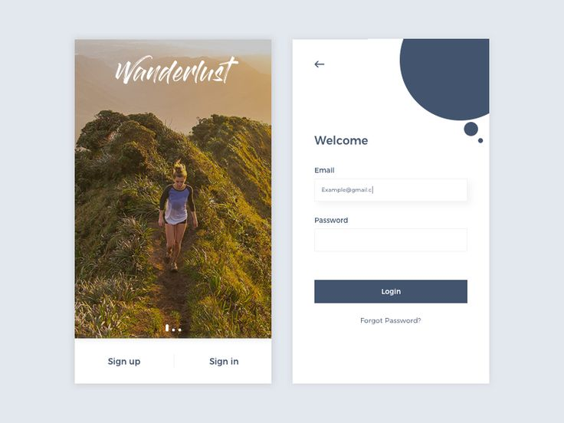
OUTPUT:

Slide 19
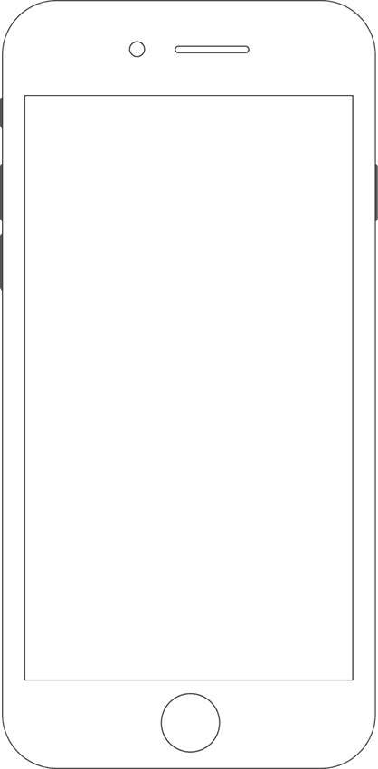
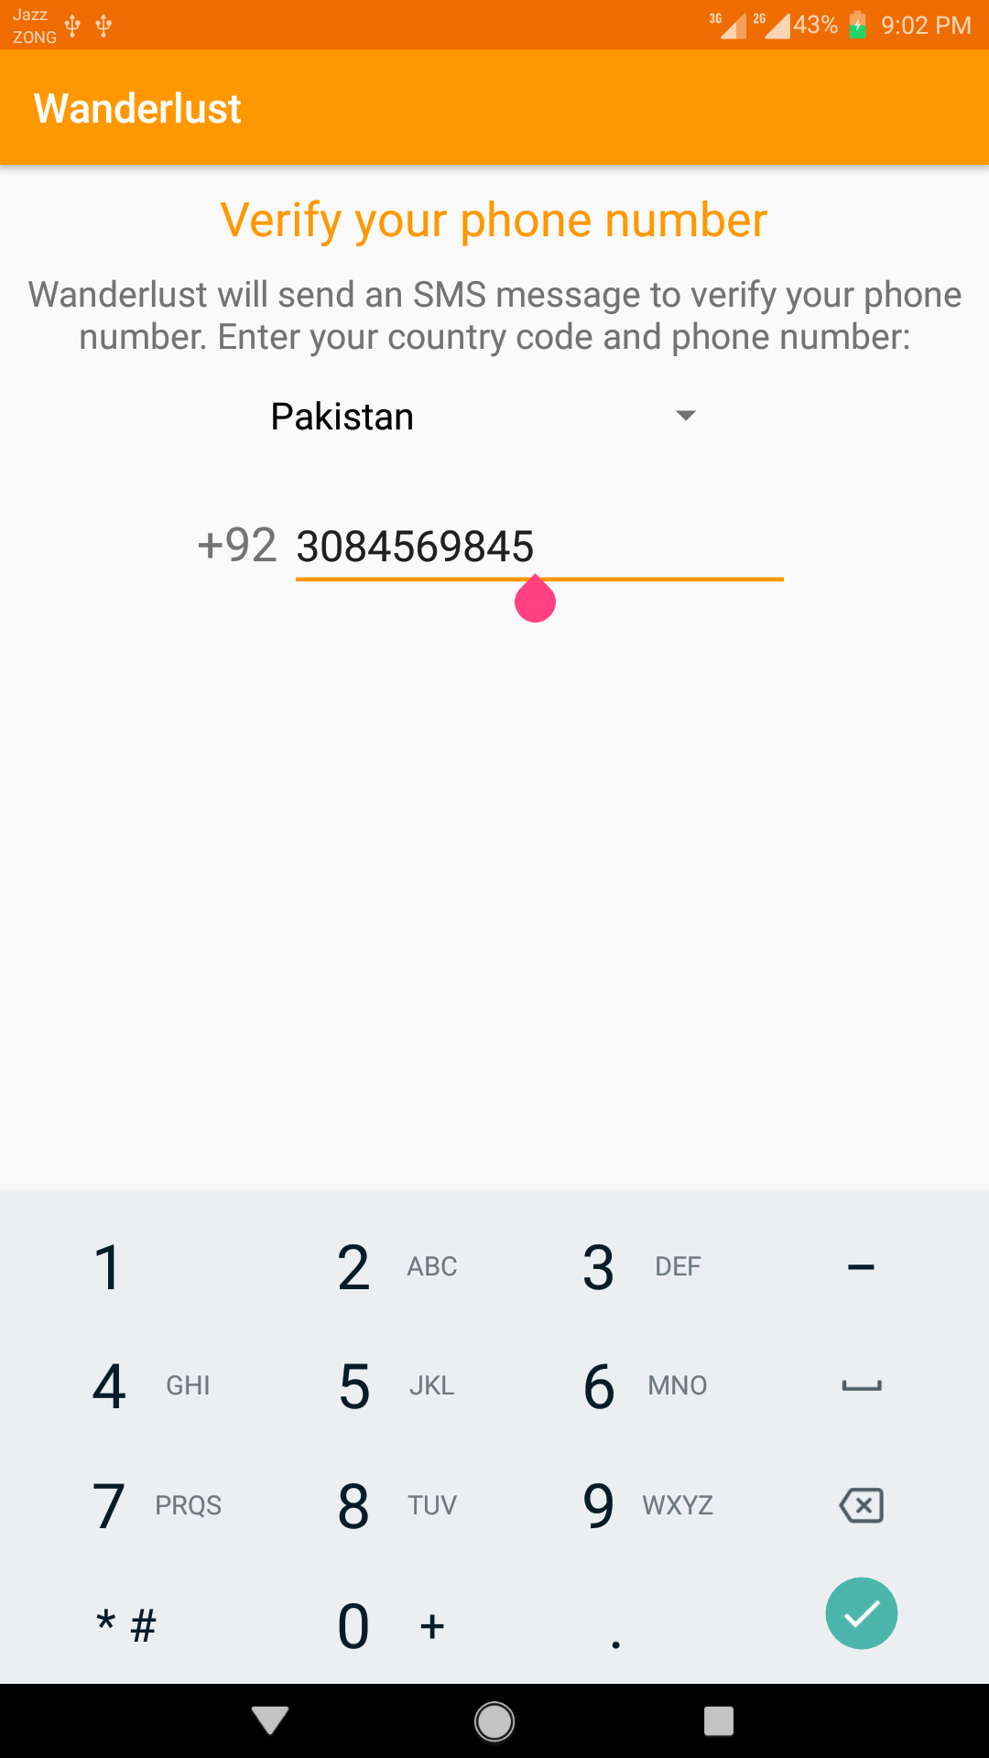
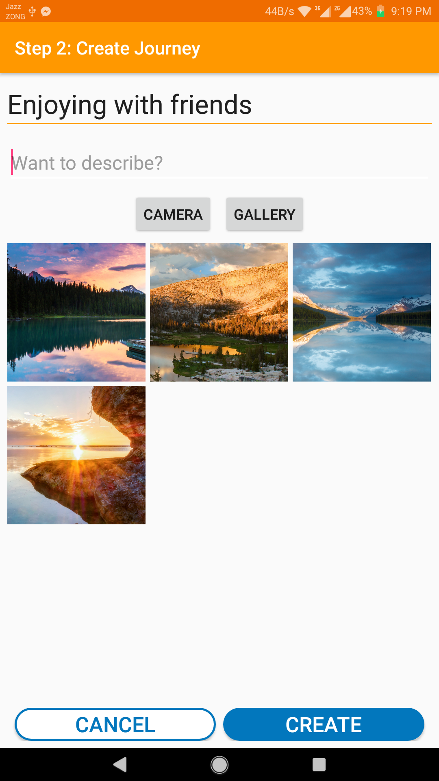
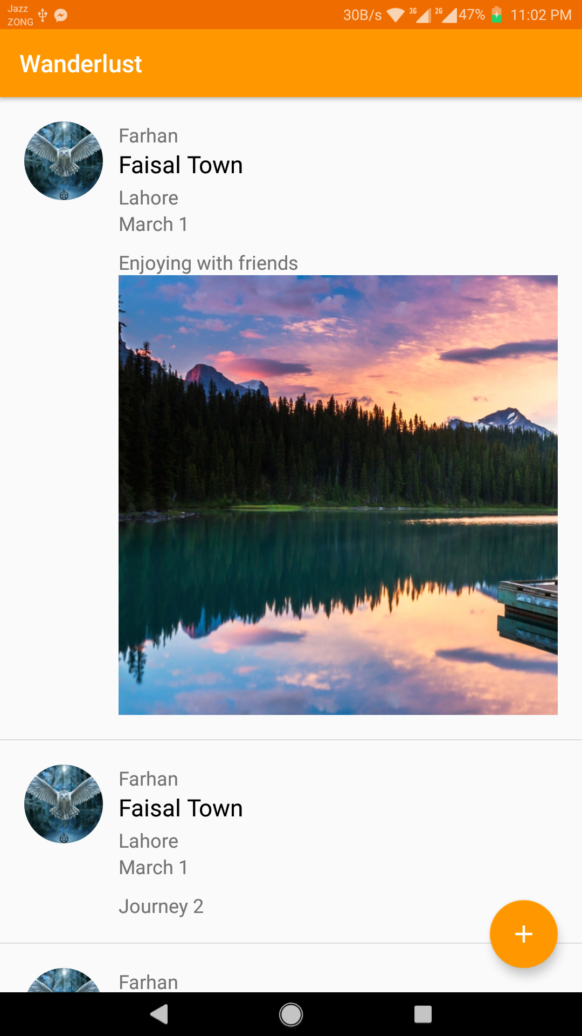
Consistent Theme

Slide 20
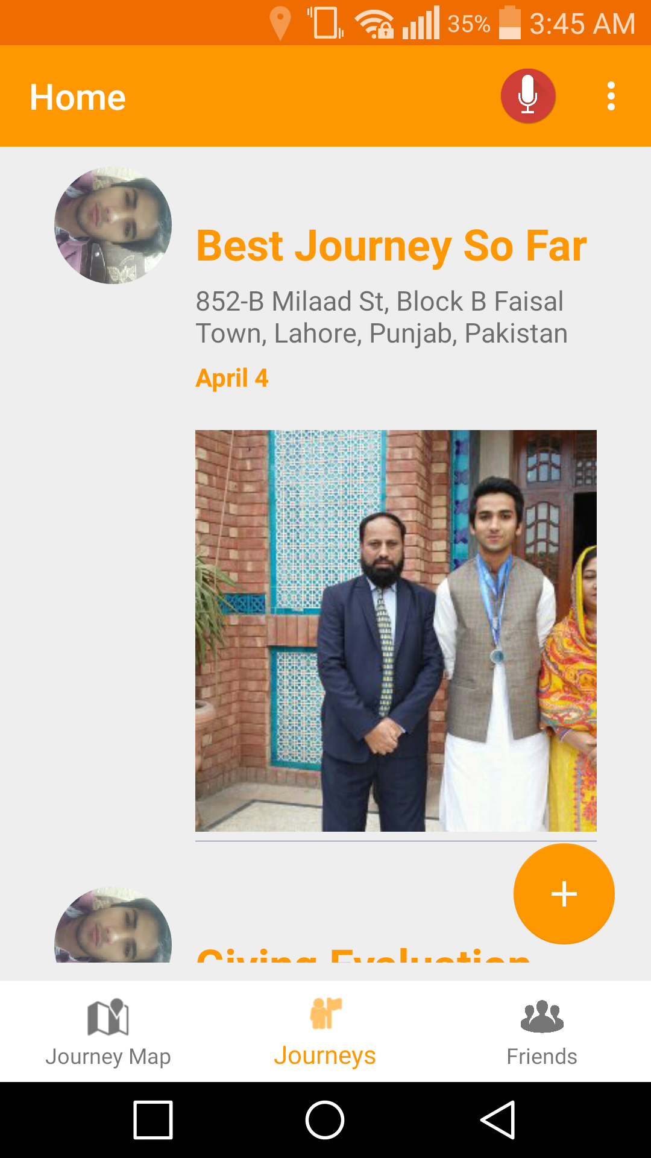
Enhanced Visibility – Navigation Bar

Slide 21

3- Splash Screens
Splash screen is new trend in apps and its attractive for users, hence we incorporated it.

Slide 22
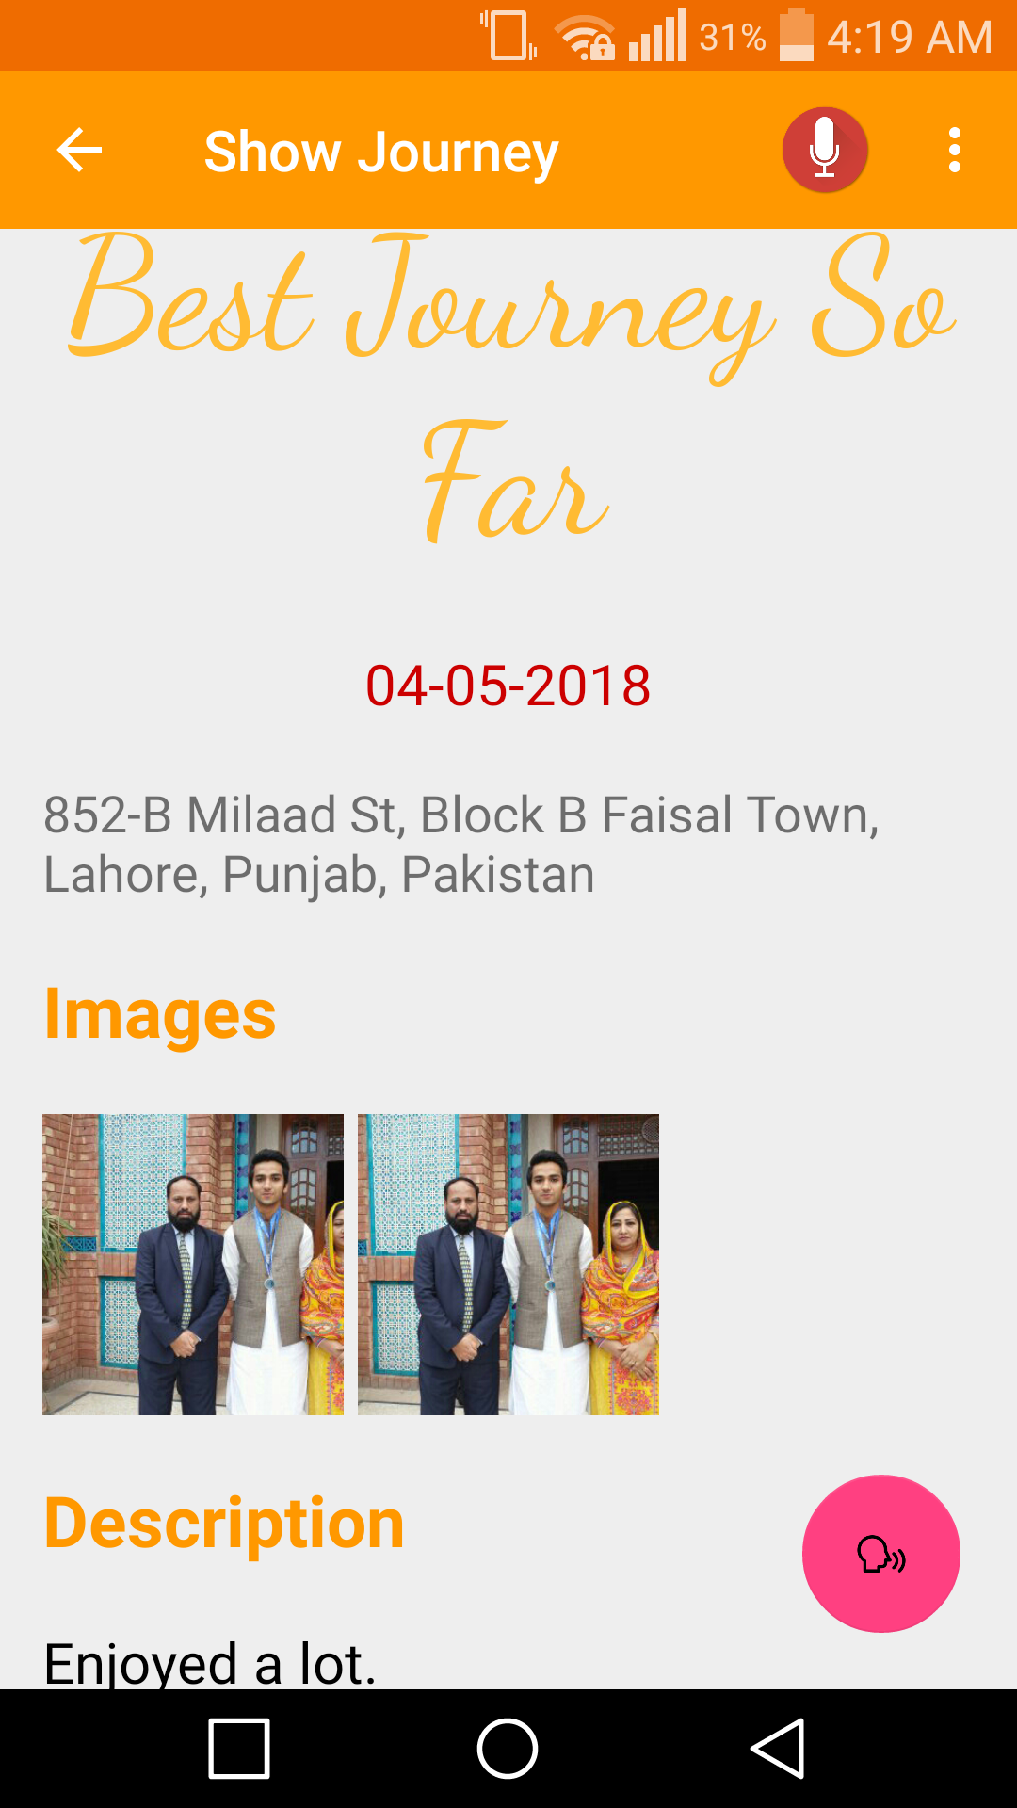
4- Audio Feedback using Text to Speech
The journey description can be read aloud for users with some vision problems. The pink coloured icon is the text to speech button.

Slide 23
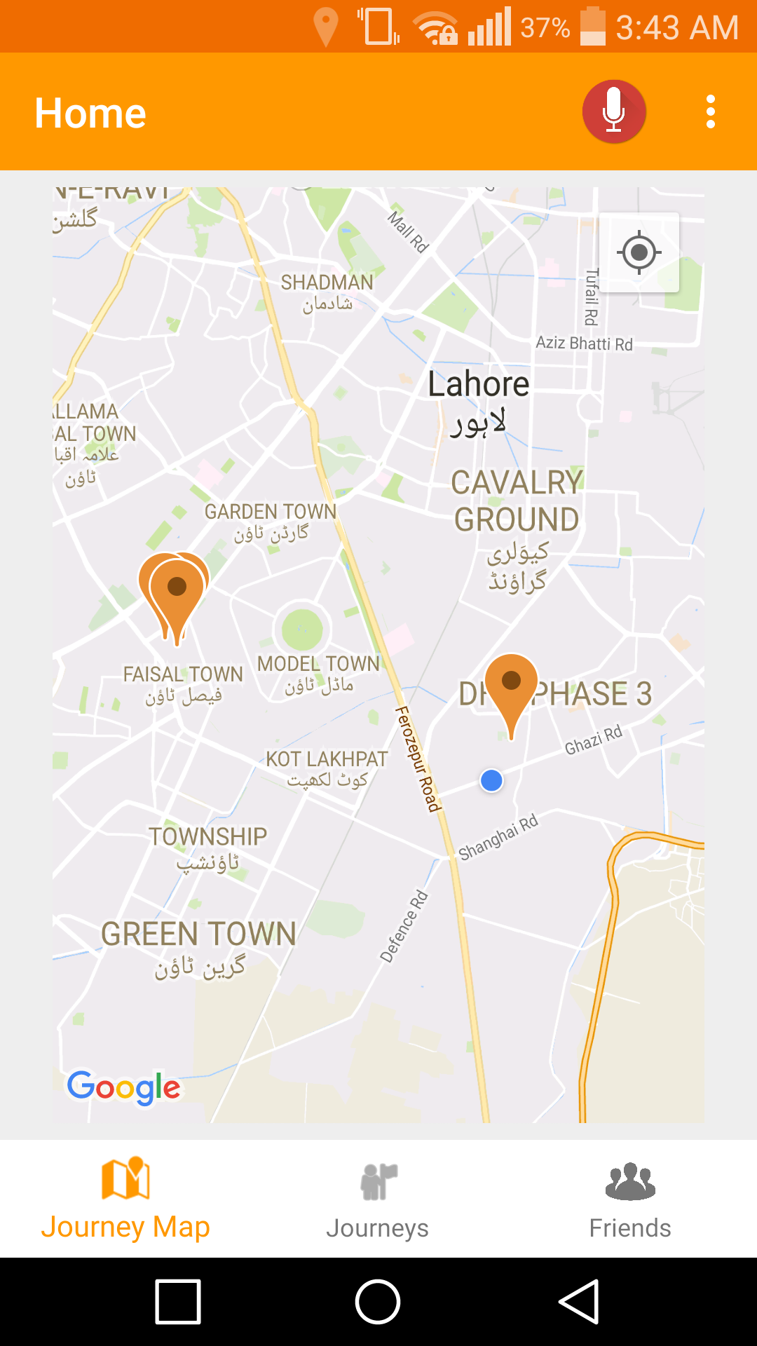
5- Enhancing Accessibility: Using a Map with Journeys as labels
A map is created with labels placed on those locations which the user has visited, making the corresponding journey easily accessible.

Slide 24
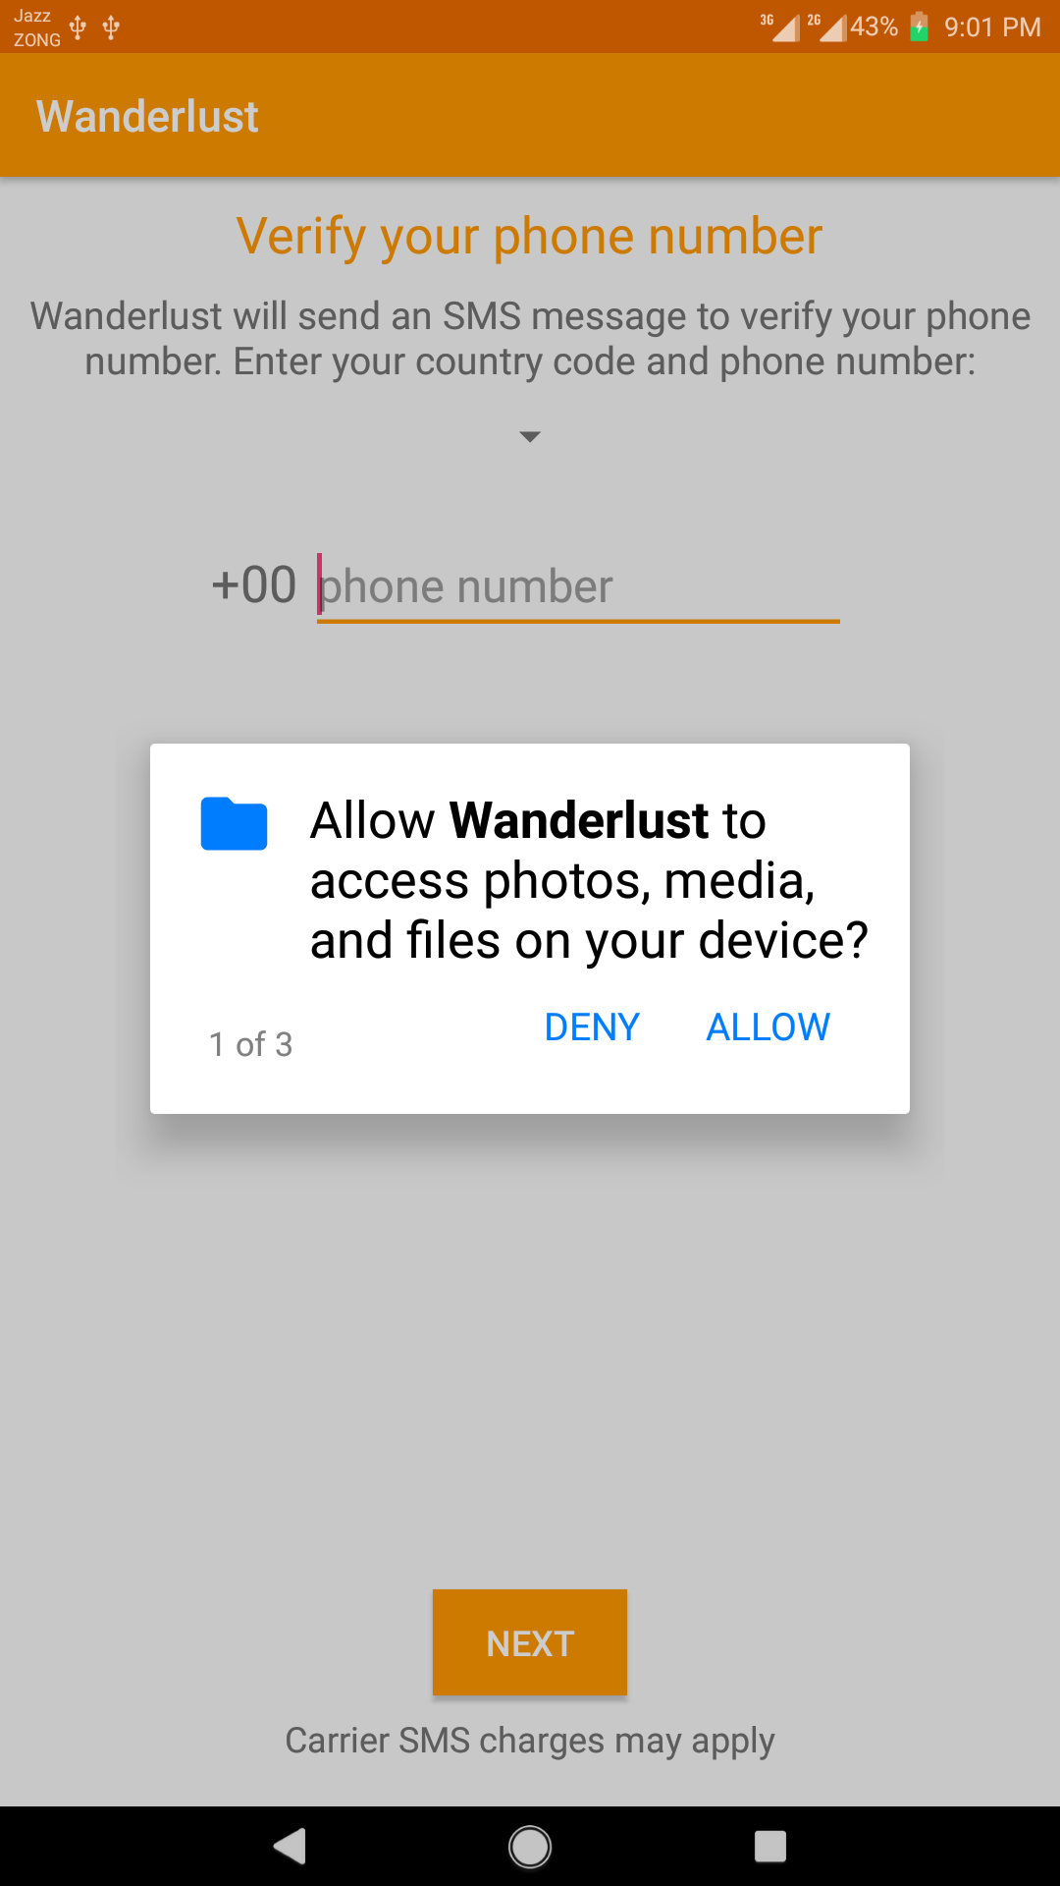
5- Keep Users in Control
User is the initiator of every action so he feels that he is in control over the app.
E.g
User is in control to allow certain permissions for app.

